Slide 1




Multidimensional Arrays
Processing Matrices, Jagged Arrays
Advanced
C#
SoftUni Team
Technical Trainers
Software University
http://softuni.bg

Slide 2
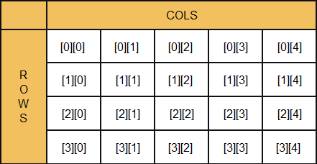
What is Multidimensional Array?
Array is a systematic arrangement of similar objects
Multidimensional arrays have more than one dimension
The most used multidimensional arrays are the 2-dimensional
Row Index
Col Index

Slide 3
What is Multidimensional Array?
Multidimensional arrays have more than one dimension
The most used multidimensional arrays are the 2-dimensional
Known as matrices or tables
0 1 2
0
1
2
4 | 6 | 3
2 | 1 | 2
6 | 7 | 9
One main array whose elements are arrays

Slide 4
Declaring and Creating Multidimensional Arrays
Declaring multidimensional arrays:
Creating a multidimensional array
Use new keyword
Must specify the size of each dimension
int[,] intMatrix;
float[,] floatMatrix;
string[,,] strCube;
int[,] intMatrix = new int[3, 4];
float[,] floatMatrix = new float[8, 2];
string[,,] stringCube = new string[5, 5, 5];

Slide 5
Initializing Multidimensional Arrays
Initializing with values multidimensional array:
Matrices are represented by a list of rows
Rows consist of list of values
The first dimension comes first, the second comes next (inside the first)
int[,] matrix =
{
{1, 2, 3, 4}, // row 0 values
{5, 6, 7, 8} // row 1 values
};

Slide 6
Accessing Elements
Accessing N-dimensional array element:
Getting element value example:
Setting element value example:
nDimensionalArray[index₁, … , index_{n}]
int[,] array = {{1, 2}, {3, 4}}
int element11 = array[1, 1]; // element11 = 4
int[,] array = new int[3, 4];
for (int row = 0; row < array.GetLength(0); row++)
for (int col = 0; col < array.GetLength(1); col++)
array[row, col] = row + col;

Slide 7
Printing Matrix – Example
int[,] matrix =
{ { 5, 2, 3, 1 },
{ 1, 9, 2, 4 },
{ 9, 8, 6, 11 } };
for (int row = 0; row < matrix.GetLength(0); row++)
{
for (int col = 0; col < matrix.GetLength(1); col++)
{
Console.Write("{0} ", matrix[row, col]);
}
Console.WriteLine();
}
Gets length of 0th dimension (rows)
Gets length of 1st dimension (columns)

Slide 8
Problem: Sum of All Elements of Matrix
Read matrix from the console
Print number of rows
Print number of columns
Print the sum of given array
int[,] matrix = {
{ 5, 2, 3, 1 },
{ 1, 9, 2, 4 },
{ 9, 8, 6, 11 }
};
3
5
61

Slide 9
Solution: Sum of All elements of Matrix
Gets length of 0th dimension (rows)
int sum = 0;
for (int row = 0; row < matrix.Length; row++)
{
for (int col = 0; col < matrix[row].Length; col++)
{
sum += matrix[row][col];
}
}
Console.WriteLine(sum);
Gets length of 1st dimension (columns)
Check your solution here: https://judge.softuni.bg/Contests/Compete/Index/599#3

Slide 10
Problem: Find Specific Square in Matrix
Find 2x2 square with max sum in given matrix
Read matrix from the console
Find biggest sum of 2x2 submatrix
Print result like new matrix
int[,] matrix = {
{7, 1, 3, 3, 2, 1},
{1, 3, 9, 8, 5, 6},
{4, 6, 7, 9, 1, 0} };
9 8
7 9
33

Slide 11
Solution: Find Specific Square in Matrix
for (int rowIndex = 0; rowIndex < matrix.Length - 1;
rowIndex++)
{
for (int colIndex = 0;
colIndex < matrix[rowIndex].Length - 1; colIndex++)
{
var newSquareSum = matrix[rowIndex][colIndex] +
matrix[rowIndex + 1][colIndex] +
matrix[rowIndex][colIndex + 1] +
matrix[rowIndex + 1][colIndex + 1];
//TODO: Check if sum is bigger
}
}
Check your solution here: https://judge.softuni.bg/Contests/Compete/Index/599#3

Slide 12
Jagged Arrays
Jagged arrays are multidimensional arrays
But each dimension has different size
A jagged array is an array of arrays
Each of the arrays has different length
 | 0 | 1 | 2 | 3
0 | 7 | 3 | 4 | 2
1 | 5 | 1
2 | 9 | 3 | 1
int[][] jagged = new int[3][];
jagged[0] = new int[3];
jagged[1] = new int[2];
jagged[2] = new int[5];

Slide 13
Filling a Jagged Array
int[][] jagged = new int[5][];
for (int i = 0; i < jagged.Length; i++)
{
string[] inputNumbers = Console.ReadLine().Split(' ');
jagged[i] = new int[inputNumbers.Length];
for (int j = 0; j < jagged[i].Lenght; j++)
{
jagged[i][j] = int.Parse(inputNumbers[j]);
}
}

Slide 14
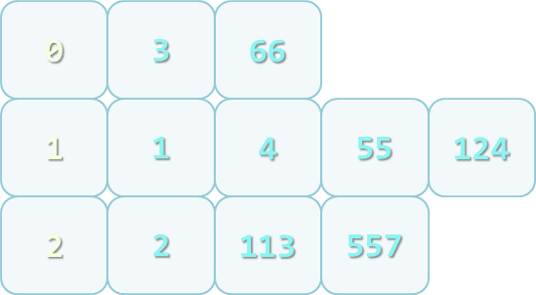
Problem: Group Numbers
Read a set of numbers and group them by their remainder when dividing to 3 (0, 1 and 2)
1, 4, 113, 55, 3, 1, 2, 66, 557, 124, 2

Slide 15
Solution: Group Numbers
int[] numbers = { 1, 4, 113, 55, 3, 1, 2, 66, 557, 124, 2 };
int[] sizes = new int[3];
foreach (var number in numbers)
{
int reminder = number % 3;
sizes[remainder]++;
}
int[][] matrix =
{
new int[sizes[0]],
new int[sizes[1]],
new int[sizes[2]]
};

Slide 16
Solution: Group Numbers (2)
int[] offsets = new int[3];
foreach (var number in numbers)
{
int reminder = number % 3;
int index = offsets[reminder];
matrix[reminder][index] = number;
offsets[reminder]++;
}
Check your solution here: https://judge.softuni.bg/Contests/Compete/Index/599#3

Slide 17
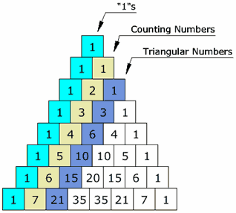
Problem: Pascal Triangle
Write a program which print on console Pascal Triangle

Slide 18
Solution: Pascal Triangle
var height = int.Parse(Console.ReadLine());
int[][] triangle = new int[height][];
int currentWidth = 1;
for (int height = 0; height < rows; height++)
{
triangle[height] = new int[currentWidth];
int[] currentRow = triangle[height];
currentRow[0] = 1;
currentRow[currentRow.Length - 1] = 1;
currentWidth++;
//TODO: Fill elements for each row (next slide)
}

Slide 19
Solution: Pascal Triangle (2)
if (currentRow.Length > 2)
{
for (int i = 1; i < currentRow.Length - 1; i++)
{
int[] previousRow = triangle[height - 1];
int prevoiousRowSum = previousRow[i] + previousRow[i - 1];
currentRow[i] = prevoiousRowSum;
}
}
Check your solution here: https://judge.softuni.bg/Contests/Compete/Index/599#3

Slide 20

Summary
Multidimensional arrays have more
than one dimension
Two-dimensional arrays are like tables
with rows and columns
Jagged arrays are arrays of arrays –
each element is an array itself

